Slide 1



Python Bootcamp Data Display with MatPlotLib
PhD Bruno C. Quint
bquint@ctio.noao.edu
Resident Astronomer at SOAR Telescope
https://github.com/b1quint/PythonBootcamp2017

Slide 2
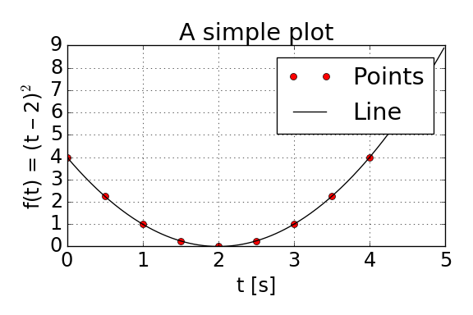
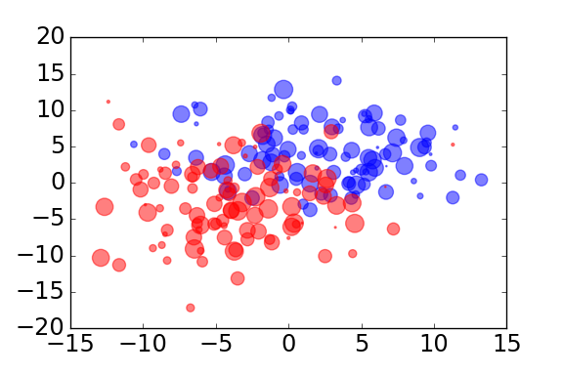
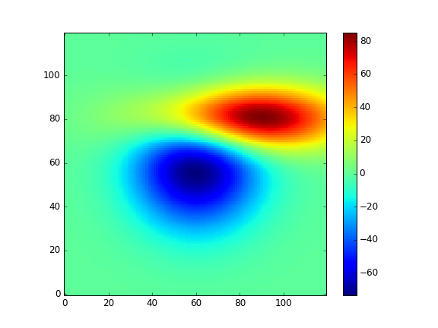
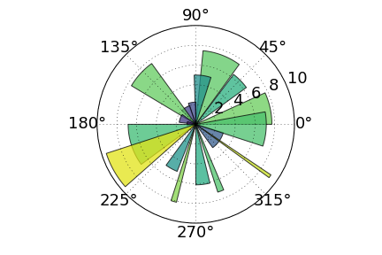
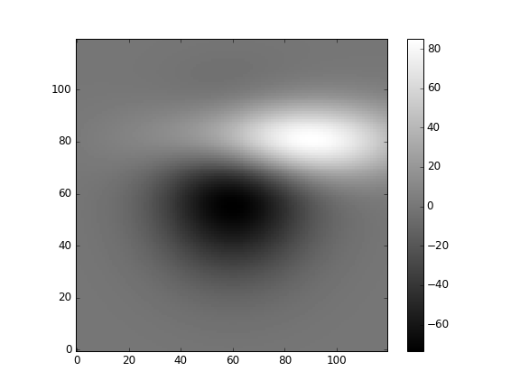
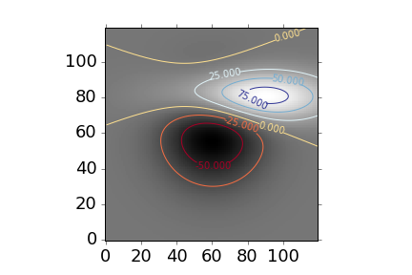
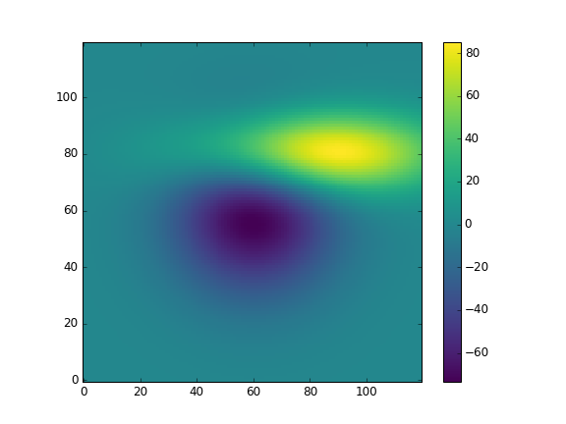
Table of Contents
A simple plot
Types of plots
Different styles

Slide 3
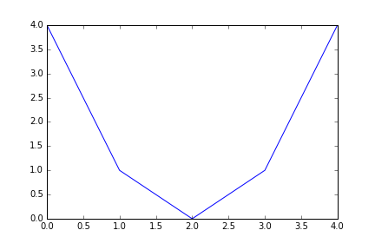
A simple plot My First Example
from matplotlib.pyplot import *
x = [0, 1, 2, 3, 4]
y = [4, 1, 0, 1, 4]
plot(x, y)
show()

Slide 4
A simple plot Save the Image!
from matplotlib.pyplot import *
x = [0, 1, 2, 3, 4]
y = [4, 1, 0, 1, 4]
plot(x, y)
savefig(‘plot_001A.png’)

Slide 5
A simple plot Save the Image!
from matplotlib.pyplot import *
x = [0, 1, 2, 3, 4]
y = [4, 1, 0, 1, 4]
plot(x, y)
savefig(‘plot_001A.png’, dpi=96)

Slide 6
A simple plot Let’s do it the “right” way
import matplotlib.pyplot as plt
x = [0, 1, 2, 3, 4]
y = [4, 1, 0, 1, 4]
plt.plot(x, y)
plt.show()

Slide 7
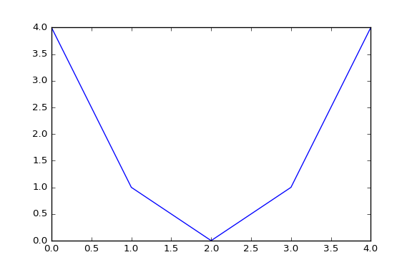
A simple plot Let’s do it the “right” way
import matplotlib.pyplot as plt
import numpy as np
x = np.arange(5)
y = (x – 2) ** 2
plt.plot(x, y)
plt.show()

Slide 8
A simple plot Plot and plot again…
plt.plot(x, y)
x = np.arange(5)
y = x ** 2 – 4 * x + 4

Slide 9
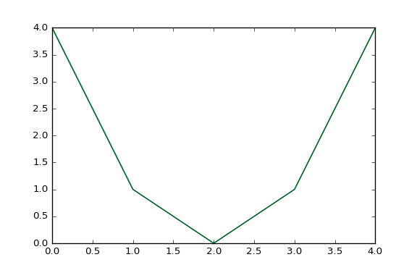
A simple plot Plot and plot again…
plt.plot(x, y)
plt.plot(x, y)
x = np.arange(5)
y = x ** 2 – 4 * x + 4

Slide 10
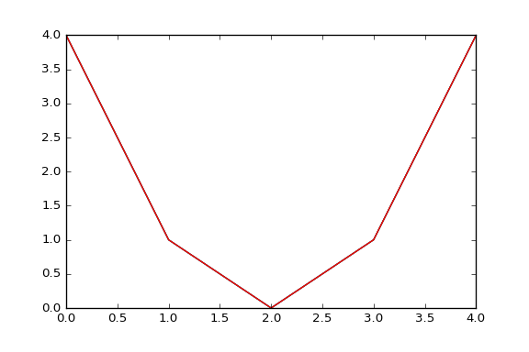
A simple plot Plot and plot again…
plt.plot(x, y)
plt.plot(x, y)
plt.plot(x, y)
x = np.arange(5)
y = x ** 2 – 4 * x + 4

Slide 11
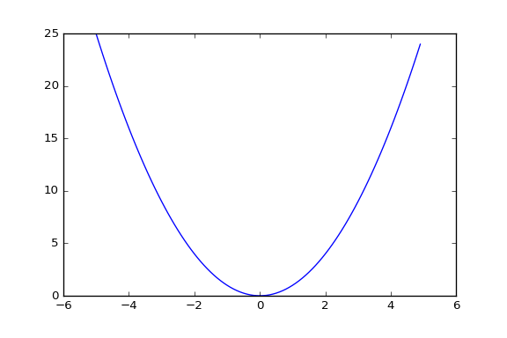
A simple plot Let’s do it the “right” way
import matplotlib.pyplot as plt
import numpy as np
x = np.arange(-5, 5, 0.1)
y = (x – 2) ** 2
plt.plot(x, y)
plt.show()

Slide 12
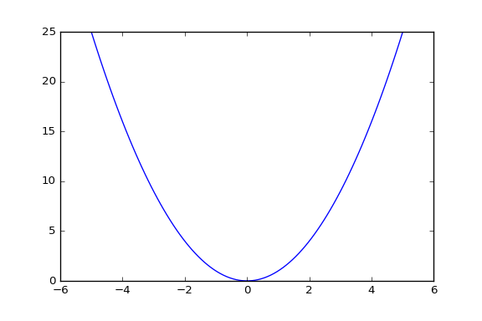
A simple plot Let’s do it the “right” way
import matplotlib.pyplot as plt
import numpy as np
x = np.linspace(-5, 5, 100)
y = (x – 2) ** 2
plt.plot(x, y)
plt.show()

Slide 13
A simple plot Plot with style
def f(t):
return (t - 2) ** 2

Slide 14
A simple plot Plot with style
def f(t):
return (t - 2) ** 2
t1 = np.arange(0.0, 5.0, 0.5)
t2 = np.arange(0.0, 5.0, 0.02)

Slide 15
A simple plot Plot with style
def f(t):
return (t - 2) ** 2
t1 = np.arange(0.0, 5.0, 0.5)
t2 = np.arange(0.0, 5.0, 0.02)
plt.plot(t1, f(t1), 'ro’)
plt.plot(t2, f(t2), 'k')

Slide 16
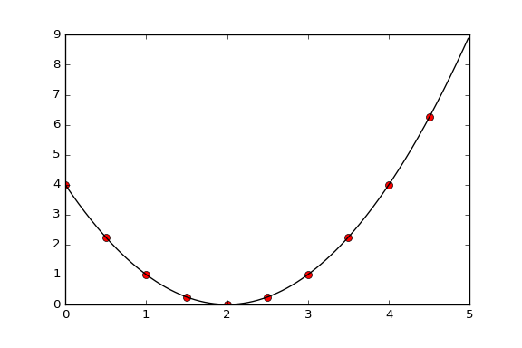
A simple plot Plot with style
def f(t):
return (t - 2) ** 2
t1 = np.arange(0.0, 5.0, 0.5)
t2 = np.arange(0.0, 5.0, 0.02)
plt.plot(t1, f(t1), 'ro', t2, f(t2), 'k')

Slide 17
A simple plot Plot with style
def f(t):
return (t - 2) ** 2
t1 = np.arange(0.0, 5.0, 0.5)
t2 = np.arange(0.0, 5.0, 0.02)
plt.plot(t1, f(t1), 'ro’, t2, f(t2), 'k')

Slide 18
A simple plot Plot with style
def f(t):
return (t - 2) ** 2
t1 = np.arange(0.0, 5.0, 0.5)
t2 = np.arange(0.0, 5.0, 0.02)
plt.plot(t1, f(t1), 'ro', t2, f(t2), 'k')

Slide 19
A simple plot Plot with style
def f(t):
return (t - 2) ** 2
t1 = np.arange(0.0, 5.0, 0.5)
t2 = np.arange(0.0, 5.0, 0.02)
plt.plot(t1, f(t1), 'ro', t2, f(t2), 'k')
plt.xlabel(“t [s]”)

Slide 20
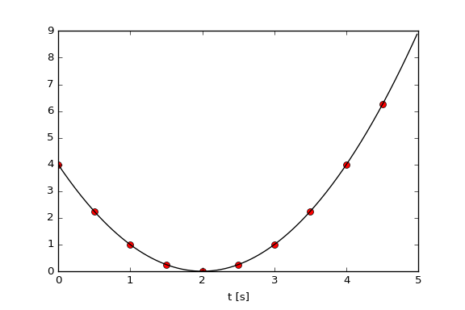
A simple plot Plot with style
def f(t):
return (t - 2) ** 2
t1 = np.arange(0.0, 5.0, 0.5)
t2 = np.arange(0.0, 5.0, 0.02)
plt.plot(t1, f(t1), 'ro', t2, f(t2), 'k')
plt.xlabel(“t [s]”)

Slide 21
A simple plot Plot with style
def f(t):
return (t - 2) ** 2
t1 = np.arange(0.0, 5.0, 0.5)
t2 = np.arange(0.0, 5.0, 0.02)
plt.plot(t1, f(t1), 'ro', t2, f(t2), 'k')
plt.xlabel(“t [s]”)
plt.ylabel(u"f(t) = (t – 2)$^2$")

Slide 22
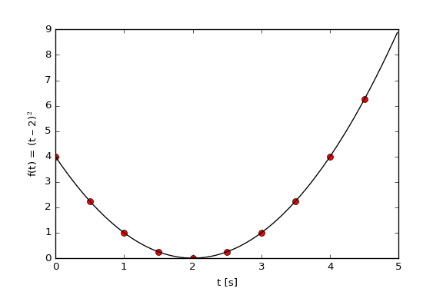
A simple plot Plot with style
def f(t):
return (t - 2) ** 2
t1 = np.arange(0.0, 5.0, 0.5)
t2 = np.arange(0.0, 5.0, 0.02)
plt.plot(t1, f(t1), 'ro', t2, f(t2), 'k')
plt.xlabel(“t [s]”)
plt.ylabel(u"f(t) = (t – 2)$^2$")

Slide 23
A simple plot Plot with style
def f(t):
return (t - 2) ** 2
t1 = np.arange(0.0, 5.0, 0.5)
t2 = np.arange(0.0, 5.0, 0.02)
plt.plot(t1, f(t1), 'ro', t2, f(t2), 'k')
plt.xlabel(“t [s]”, fontsize=24)
plt.ylabel(u"f(t) = (t – 2)$^2$”,
fontsize=24)

Slide 24
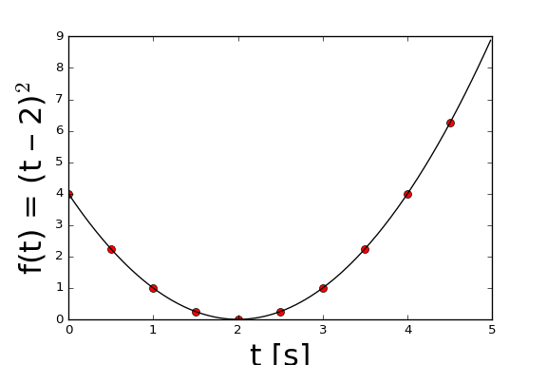
A simple plot Plot with style
def f(t):
return (t - 2) ** 2
t1 = np.arange(0.0, 5.0, 0.5)
t2 = np.arange(0.0, 5.0, 0.02)
plt.plot(t1, f(t1), 'ro', t2, f(t2), 'k')
plt.xlabel(“t [s]”, fontsize=24)
plt.ylabel(u"f(t) = (t – 2)$^2$”,
fontsize=24)

Slide 25
A simple plot Plot with style
def f(t):
return (t - 2) ** 2
t1 = np.arange(0.0, 5.0, 0.5)
t2 = np.arange(0.0, 5.0, 0.02)
plt.plot(t1, f(t1), 'ro', t2, f(t2), 'k')
plt.xlabel(“t [s]”, fontsize=24)
plt.ylabel(u"f(t) = (t – 2)$^2$”,
fontsize=24)
plt.xticks(fontsize=18)

Slide 26
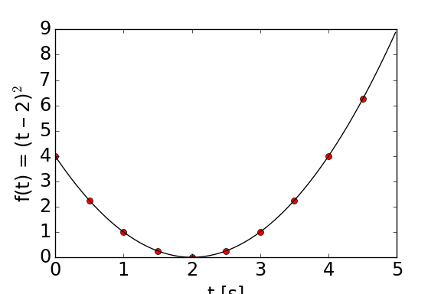
A simple plot Plot with style
def f(t):
return (t - 2) ** 2
t1 = np.arange(0.0, 5.0, 0.5)
t2 = np.arange(0.0, 5.0, 0.02)
plt.plot(t1, f(t1), 'ro', t2, f(t2), 'k')
plt.xlabel(“t [s]”, fontsize=24)
plt.ylabel(u"f(t) = (t – 2)$^2$”,
fontsize=24)

Slide 27
A simple plot Plot with style
>>> import matplotlib as mpl
>>> print mpl.rcParams['font.size']
10
>>> mpl.rcParams['font.size'] = 18
>>> plt.plot(t1, f(t1), 'ro')
>>> plt.plot(t2, f(t2), 'k')
>>> plt.xlabel('t [s]')
>>> plt.ylabel(u’f(t) = (t – 2)$^s$’)

Slide 28
A simple plot Plot with style
>>> import matplotlib as mpl
>>> print mpl.rcParams['font.size']
10
>>> mpl.rcParams['font.size'] = 18
>>> plt.plot(t1, f(t1), 'ro')
>>> plt.plot(t2, f(t2), 'k')
>>> plt.xlabel('t [s]')
>>> plt.ylabel(u’f(t) = (t – 2)$^s$’)

Slide 29
A simple plot Plot with style
>>> plt.title(“A simple plot”)

Slide 30
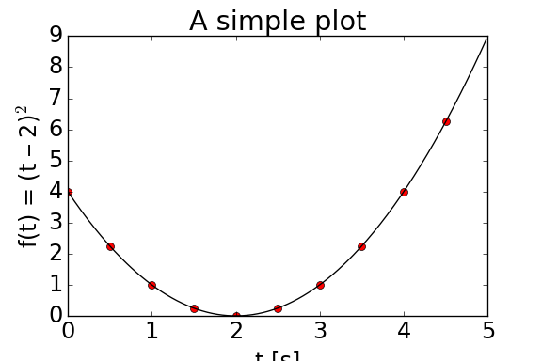
A simple plot Plot with style
>>> plt.title(“A simple plot”)

Slide 31
A simple plot Plot with style
>>> plt.grid()

Slide 32
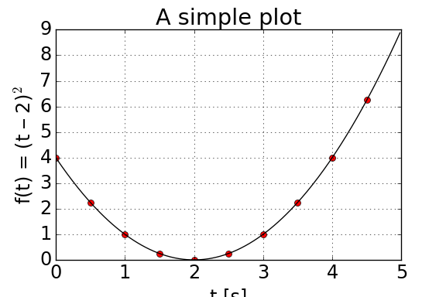
A simple plot Plot with style
>>> plt.grid()

Slide 33
A simple plot Plot with style
>>> plt.plot(t1, f(t1), 'ro', label="Points")
>>> plt.plot(t2, f(t2), 'k', label="Line")
>>> plt.legend()

Slide 34
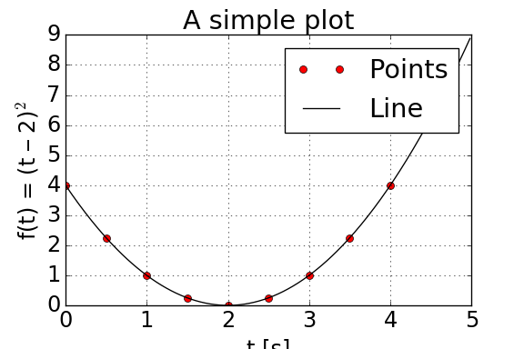
A simple plot Plot with style
>>> plt.plot(t1, f(t1), 'ro', label="Points")
>>> plt.plot(t2, f(t2), 'k', label="Line")
>>> plt.legend()

Slide 35
A simple plot Plot with style
>>> plt.plot(t1, f(t1), 'ro', label="Points")
>>> plt.plot(t2, f(t2), 'k', label="Line")
>>> plt.legend()

Slide 36
A simple plot Plot with style
>>> plt.tight_layout()

Slide 37
A simple plot Plot with style
>>> plt.tight_layout()

Slide 38
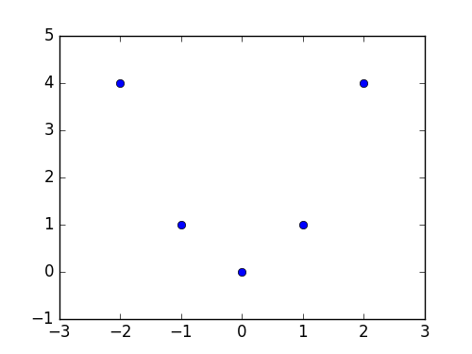
A good practice
x = np.arange(5) - 2
y = x ** 2
fig = plt.figure()
ax = fig.add_subplot(111)
ax.plot(x, y, ‘o’)
ax.set_xlim(-3, 3)
ax.set_xlim(-1, 5)
plt.show()

Slide 39
Some advanced MatPlotLib
x = np.arange(5) - 2
y = x ** 2
fig = plt.figure()
ax = fig.add_subplot(111)
ax.plot(x, y, ‘o’)
ax.set_xlim(-3, 3)
ax.set_xlim(-1, 5)
plt.show()

Slide 40
Some advanced MatPlotLib
x = np.arange(5) - 2
y = x ** 2
fig = plt.figure()
ax = fig.add_subplot(111)
ax.plot(x, y, ‘o’)
ax.set_xlim(-3, 3)
ax.set_xlim(-1, 5)
plt.show()

Slide 41
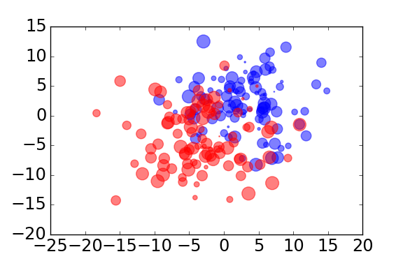
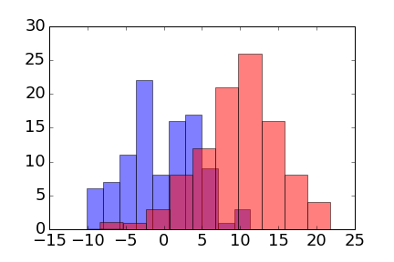
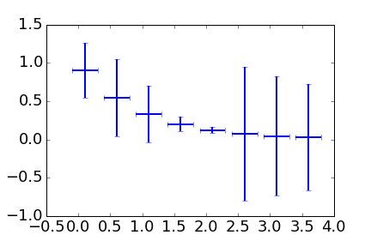
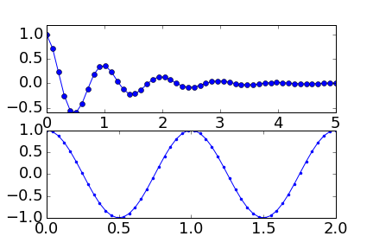
Types of plots
Scatter Plot
Histogram
Errorbar Plots
Multiple Axis

Slide 42
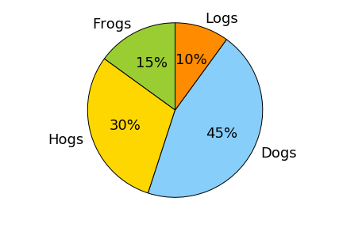
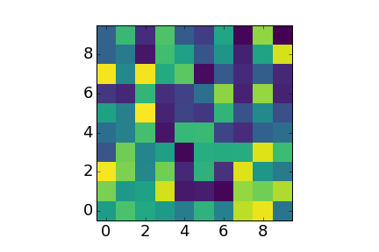
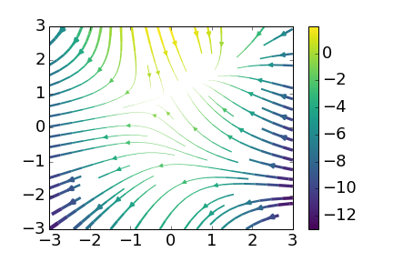
Types of plots
Pie Plots
Polar Plots
Display Images
Stream Plots

Slide 43
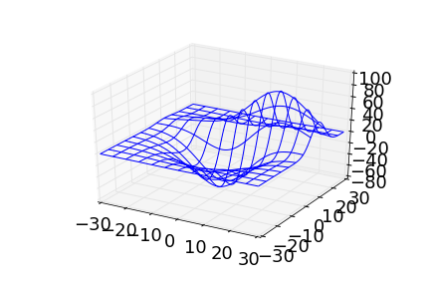
Types of plots
Plots 3D
Contour Plots

Slide 44
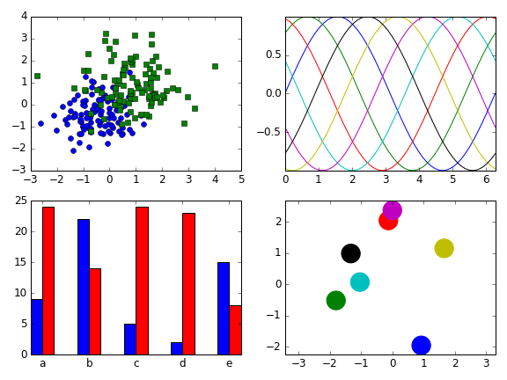
Different Styles
Default

Slide 45
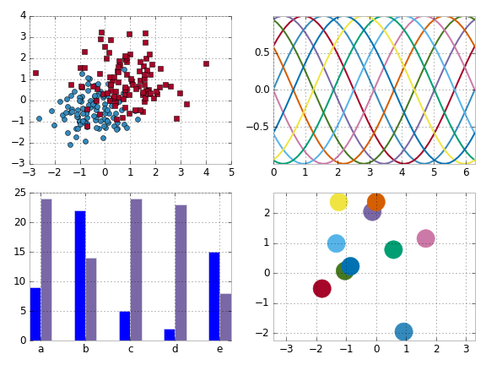
Different Styles
bmh

Slide 46
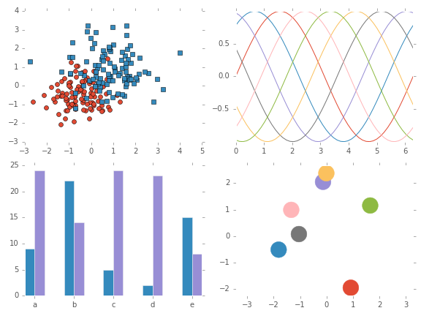
Different Styles
ggplot

Slide 47
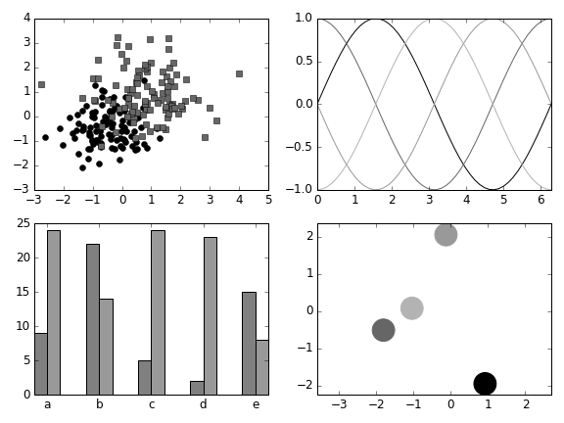
Different Styles
grayscale

Slide 48
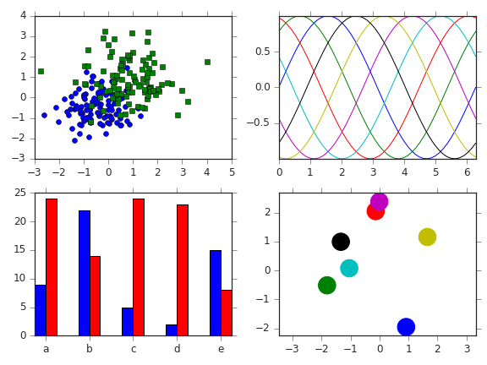
Different Styles
seaborn-ticks

Slide 49
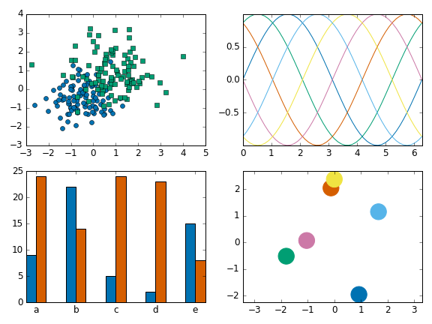
Different Styles
seaborn-colorblind

Slide 50
Colormaps
jet

Slide 51
Colormaps
grayscale

Slide 52
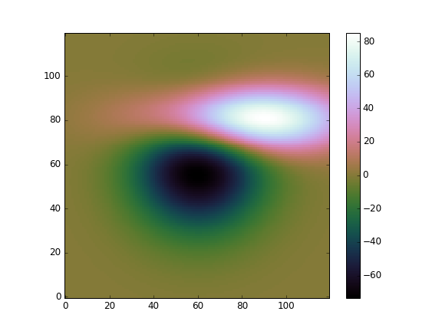
Colormaps
cubehelix

Slide 53
Colormaps
viridis

Slide 54
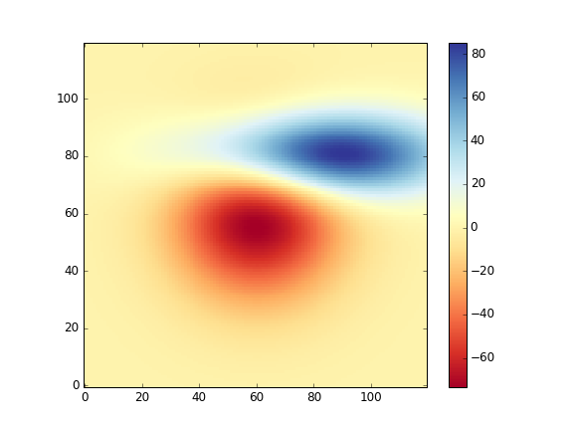
Colormaps
RdYlBu

Slide 55

Questions?

